Slide 1
BT 203 Biochemistry
Pentose Phosphate Pathway
14 Oct 2019

Slide 2
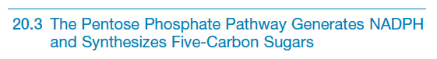
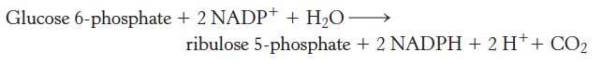
NADPH, a key product of the pentose phosphate pathway, is the source of biosynthetic reducing power.
The first phase of the pentose phosphate pathway is the oxidative generation of NADPH.
The second phase is the nonoxidative interconversion of a variety of sugars.

Slide 3
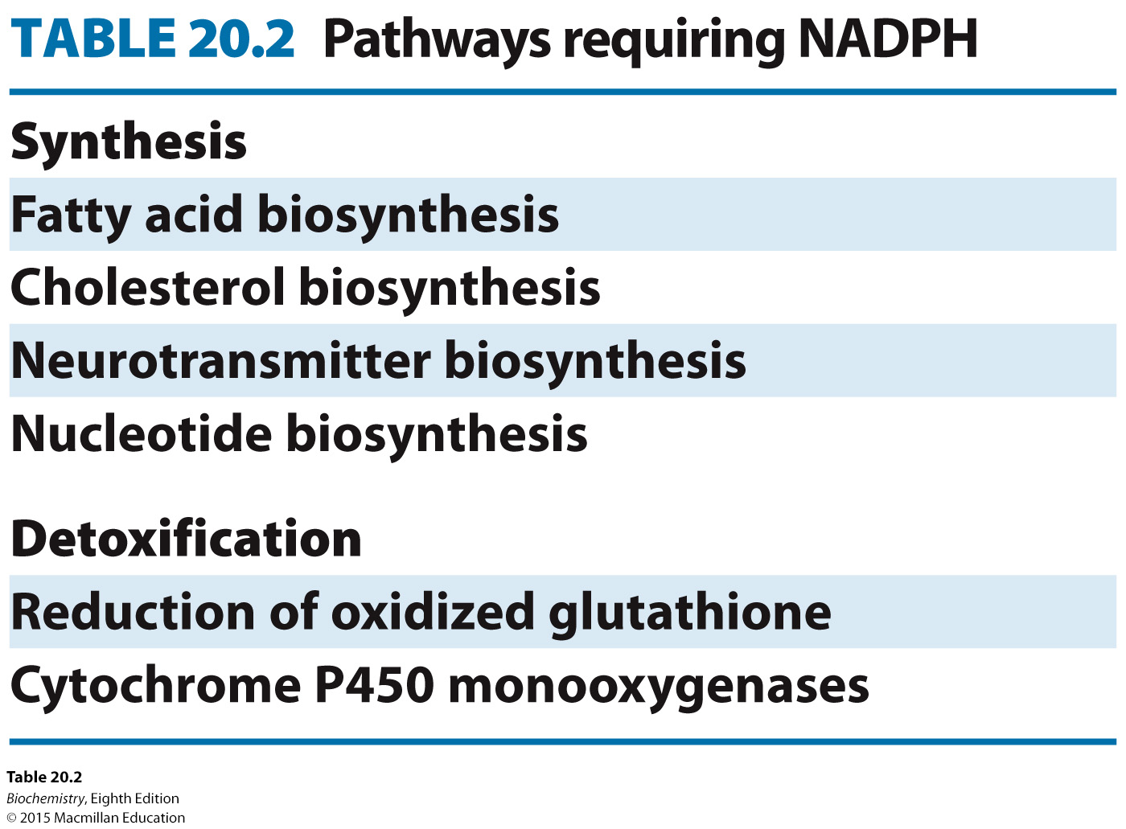

Slide 4
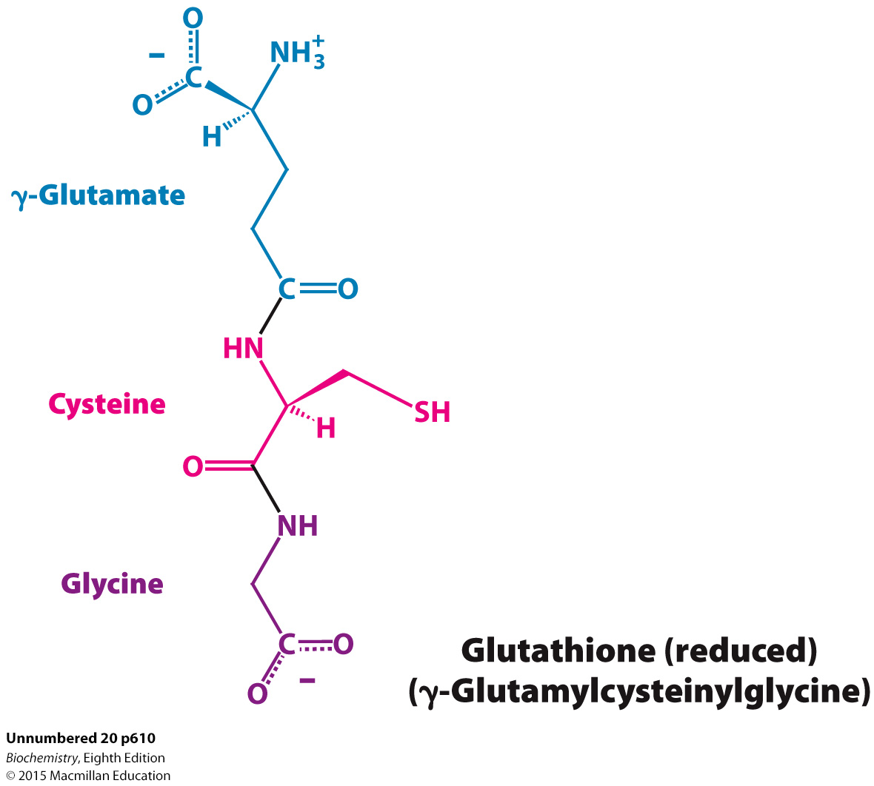

Slide 5
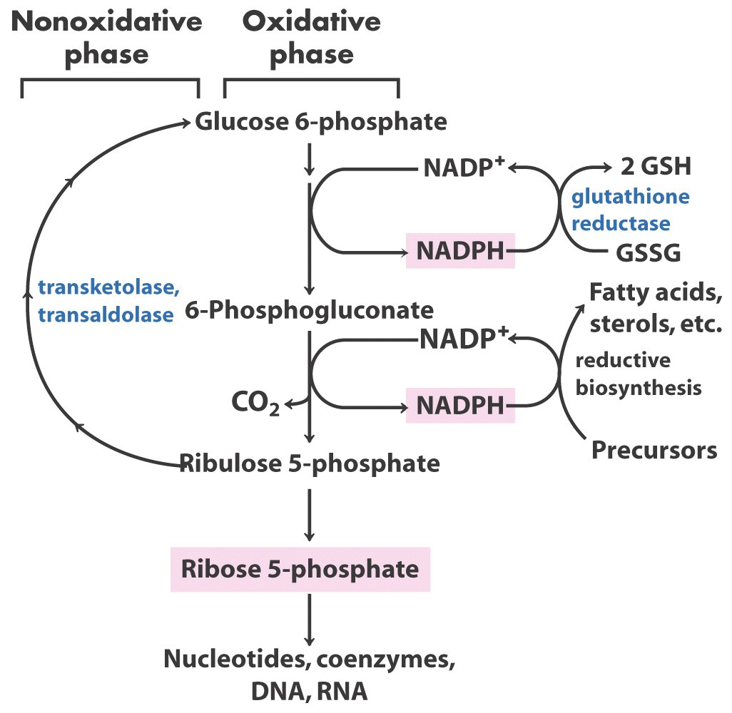

Slide 6
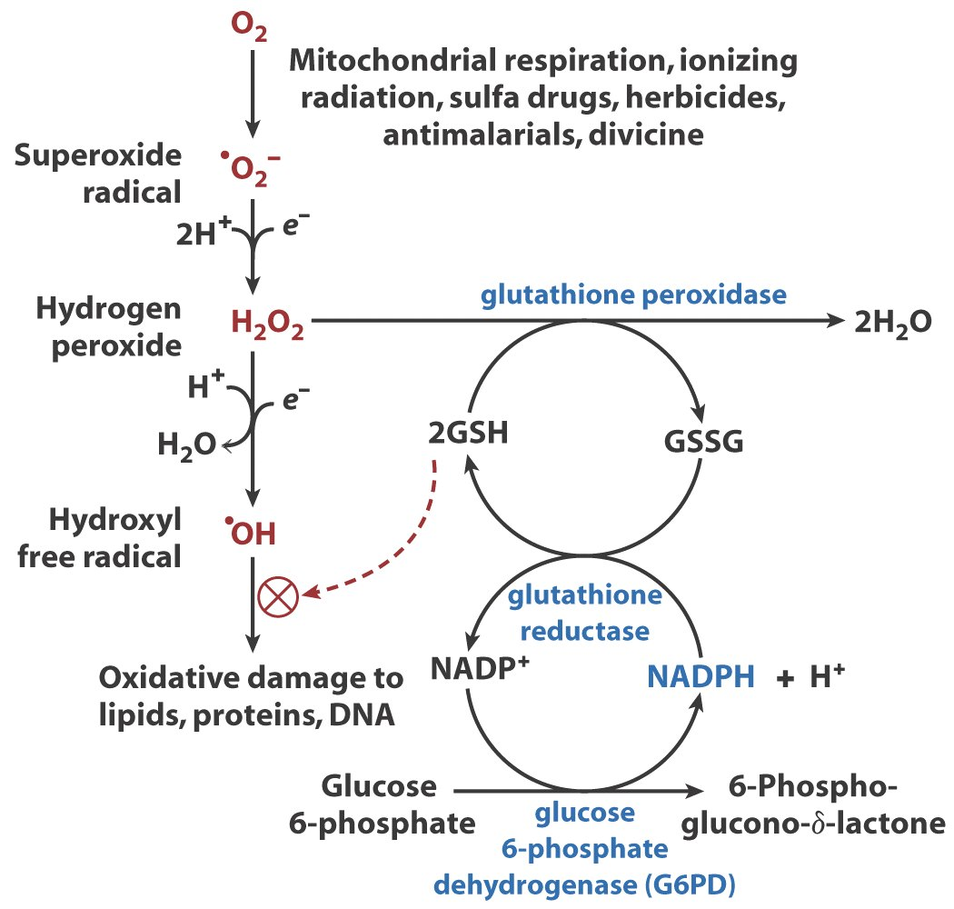
Role of NADPH and Reduced Glutathione in protecting the cell against highly reactive oxygen derivatives

Slide 7
Oxidative phase of Pentose Phosphate Pathway

Slide 9
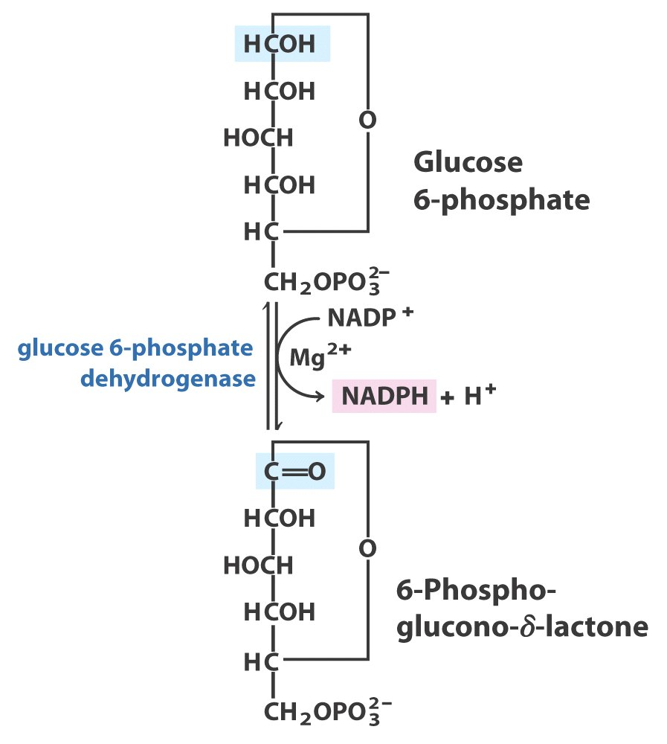

Slide 10
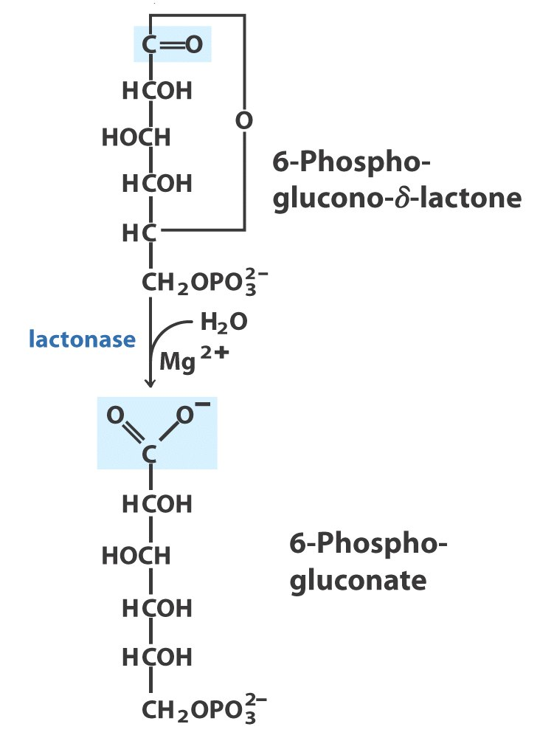

Slide 11
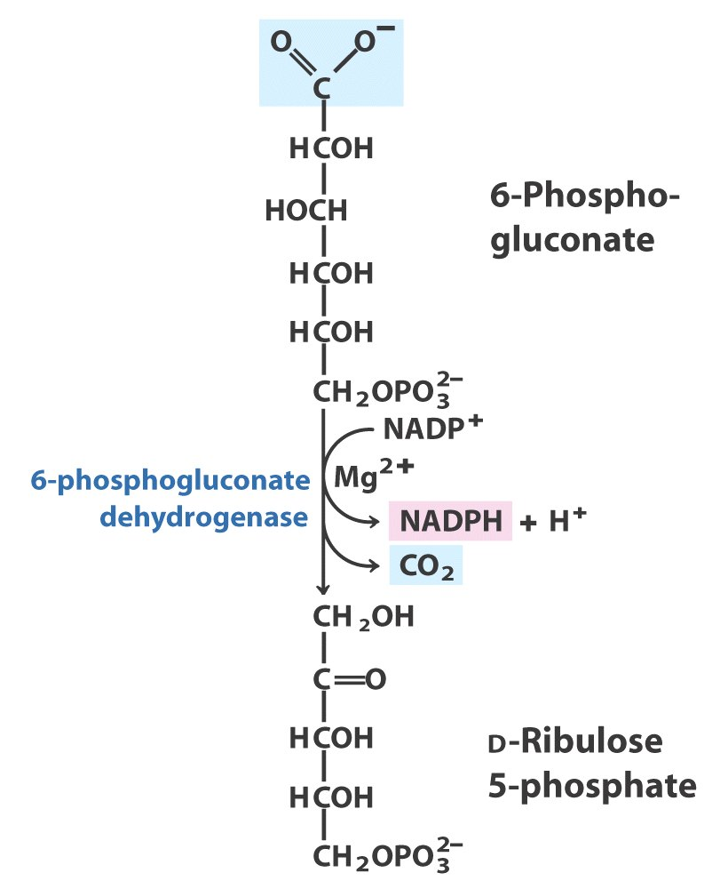

Slide 12
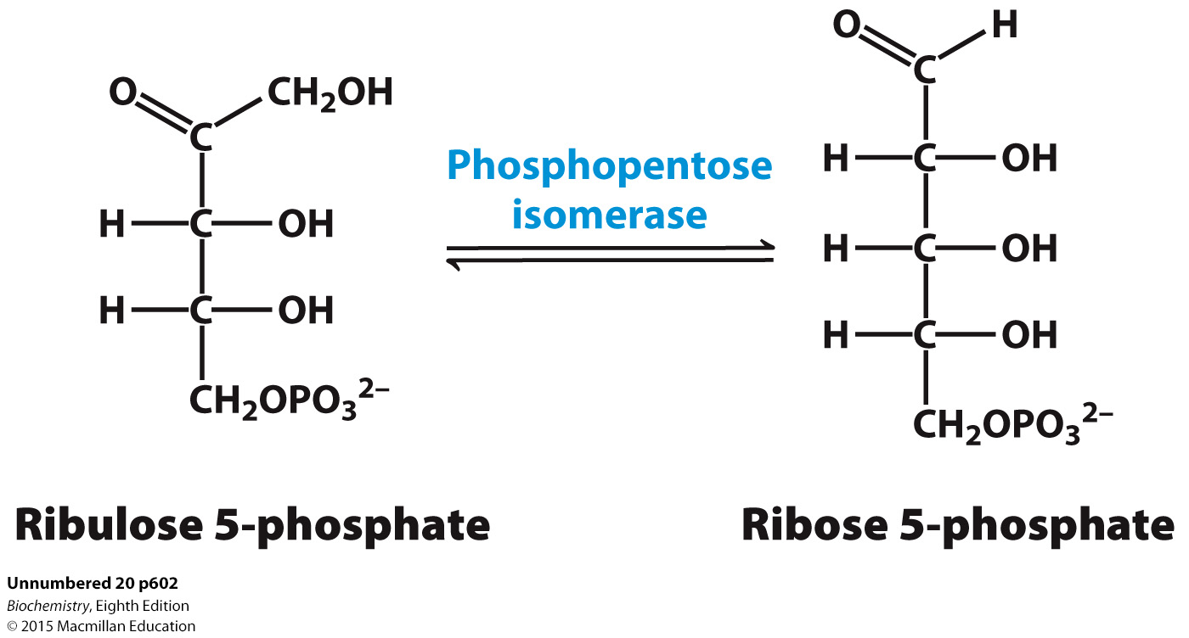
Ribulose 5-phosphate, generated by the oxidative phase, is isomerized into ribose 5-phosphate.

Slide 13
Non-oxidative phase of Pentose Phosphate Pathway

Slide 14
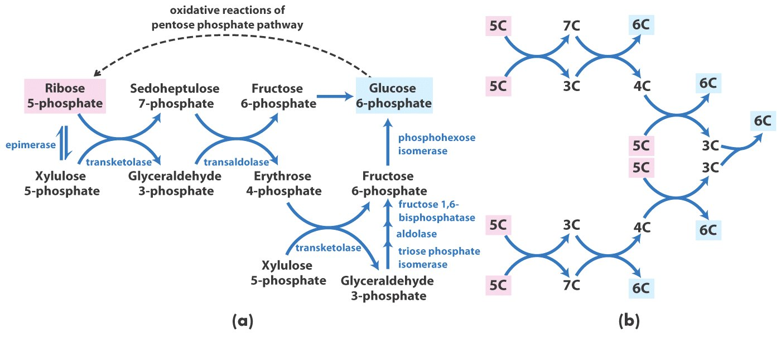

Slide 15
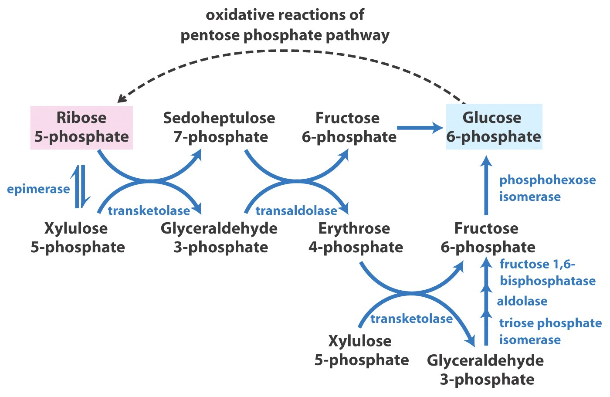

Slide 16
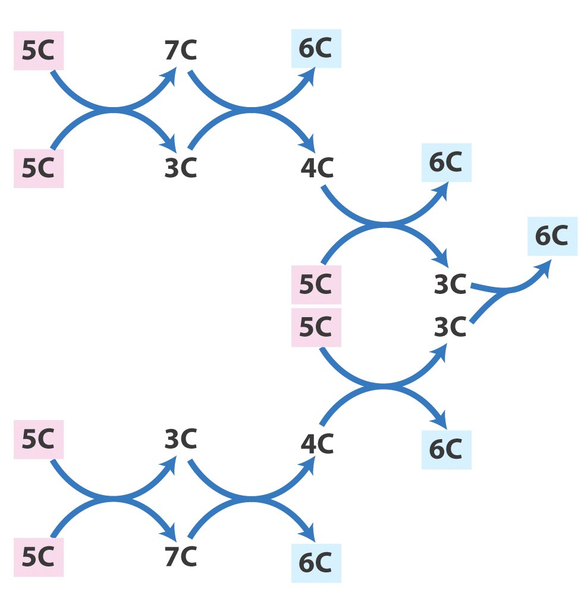

Slide 17
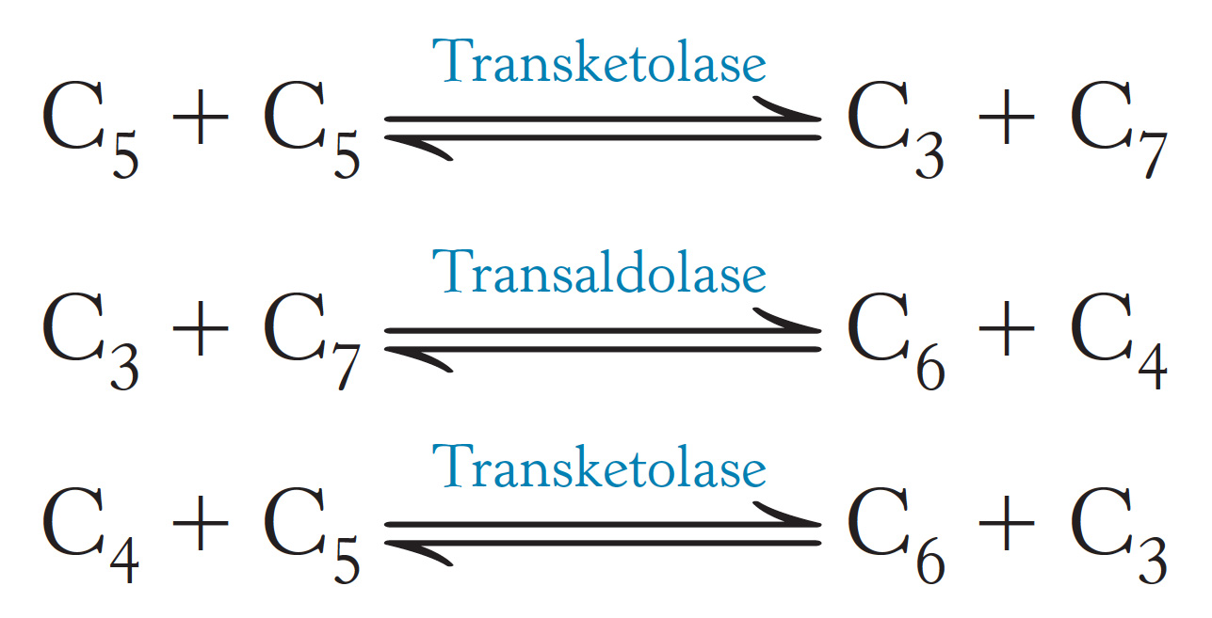
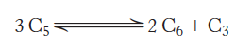
The nonoxidative phase consists of three reactions:
The net result of these reactions is the conversion of three pentoses into
two hexoses and one triose:

Slide 18
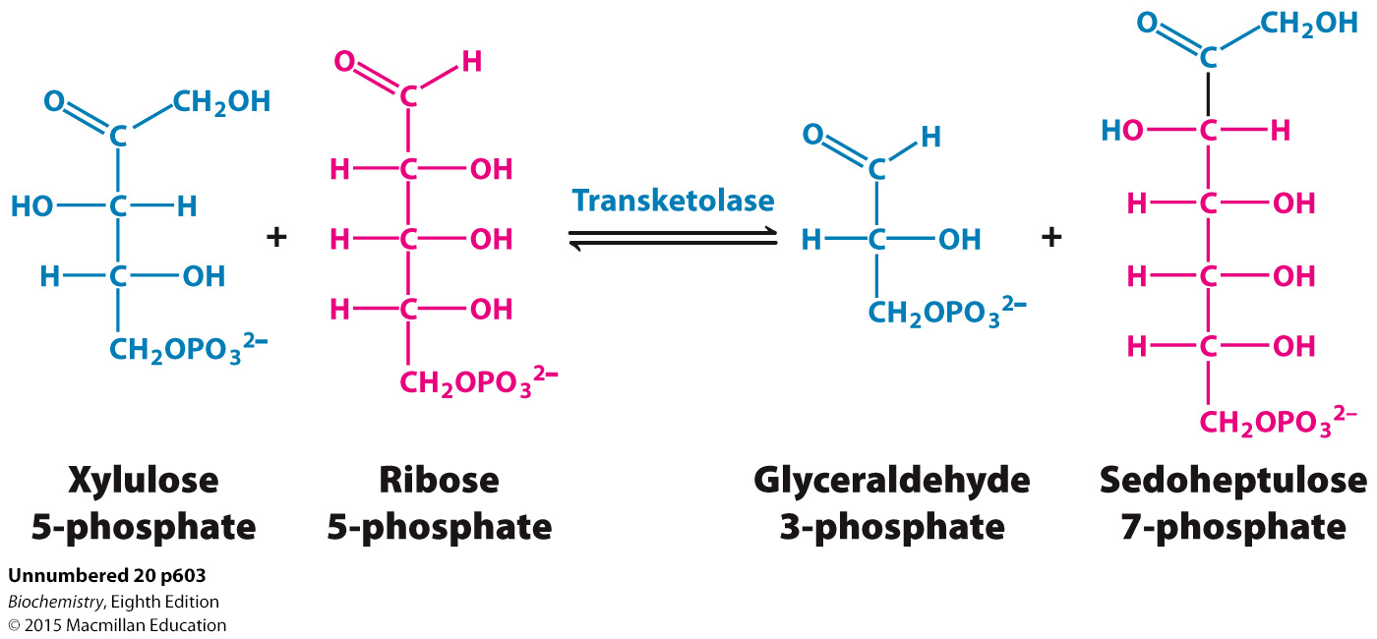
In the first reaction linking the pentose phosphate pathway and glycolysis, 2 five-carbon sugars are converted into a three-carbon and seven-carbon sugar.

Slide 19
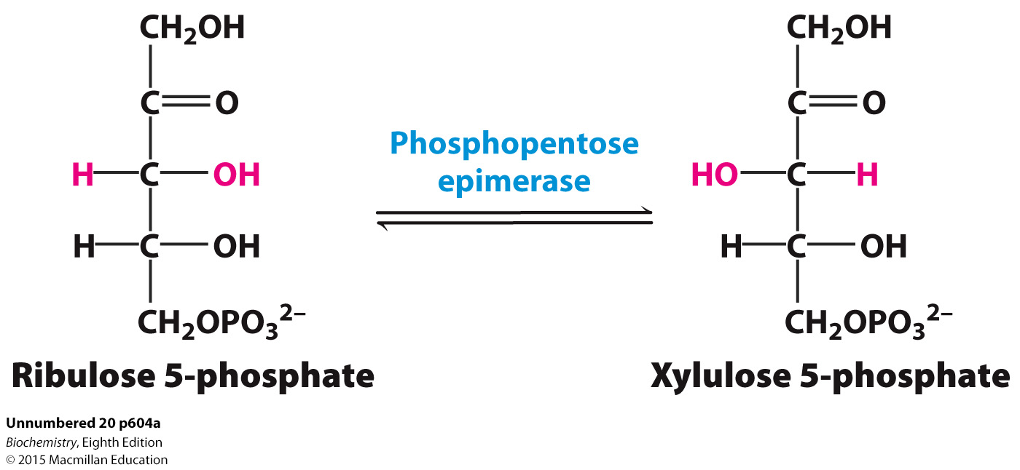
Xylulose 5-phosphate, one of the substrates for the transketolase reaction, is formed from its epimer ribulose 5-phosphate.

Slide 20
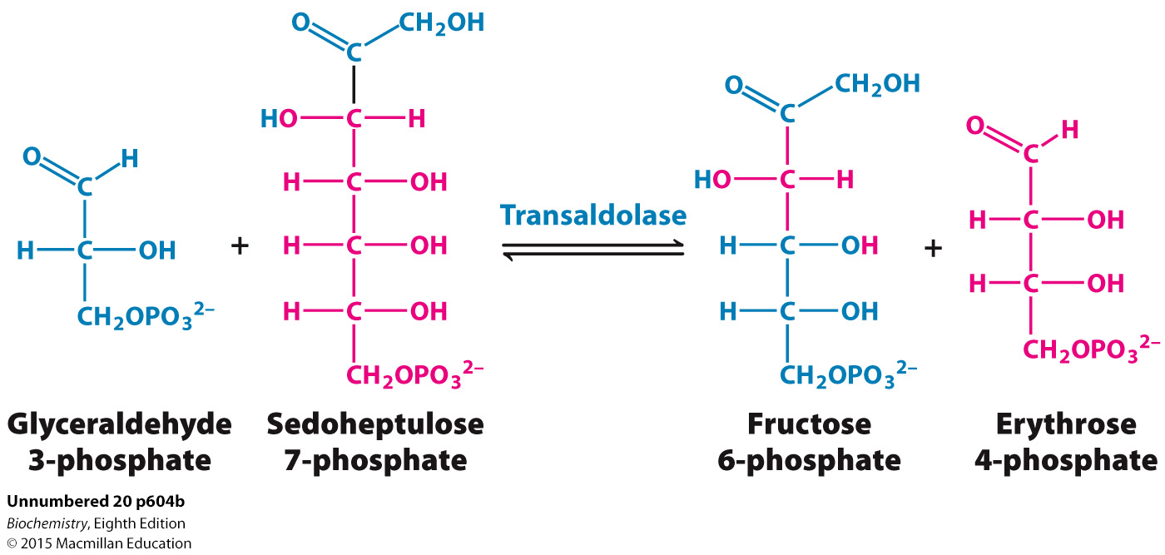
Transaldolase forms a six-carbon and a four-carbon sugar from a three-carbon and a seven-carbon sugar.

Slide 21
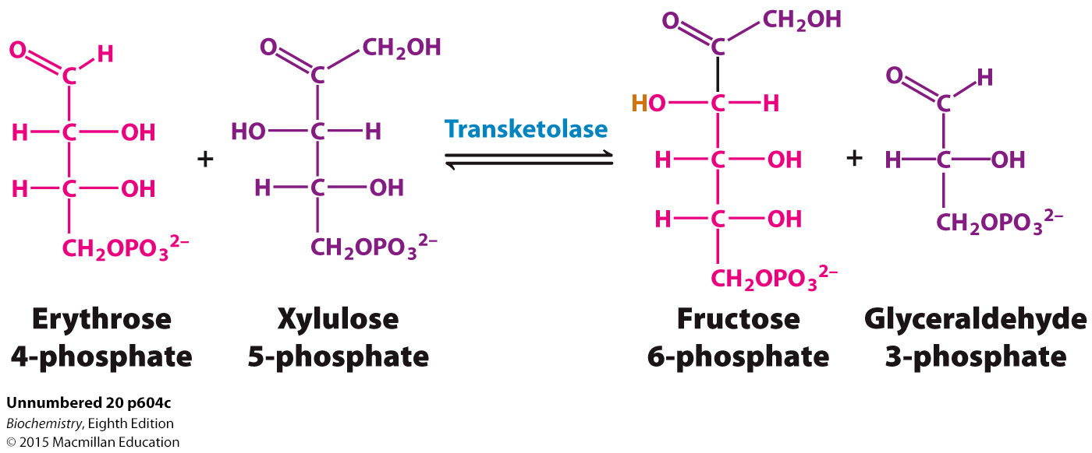
Transketolase converts a four-carbon sugar and a five-carbon sugar into a six-carbon sugar and a three-carbon sugar.

Slide 22
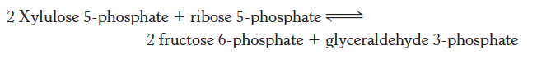
The sum of the reactions catalyzed by the epimerase, transketolase, and transaldolase shows the conversion of 3 five-carbon sugars into components of the glycolytic and gluconeogenic pathways.
Xylulose 5-phosphate can be formed from ribose 5-phosphate.

Slide 23
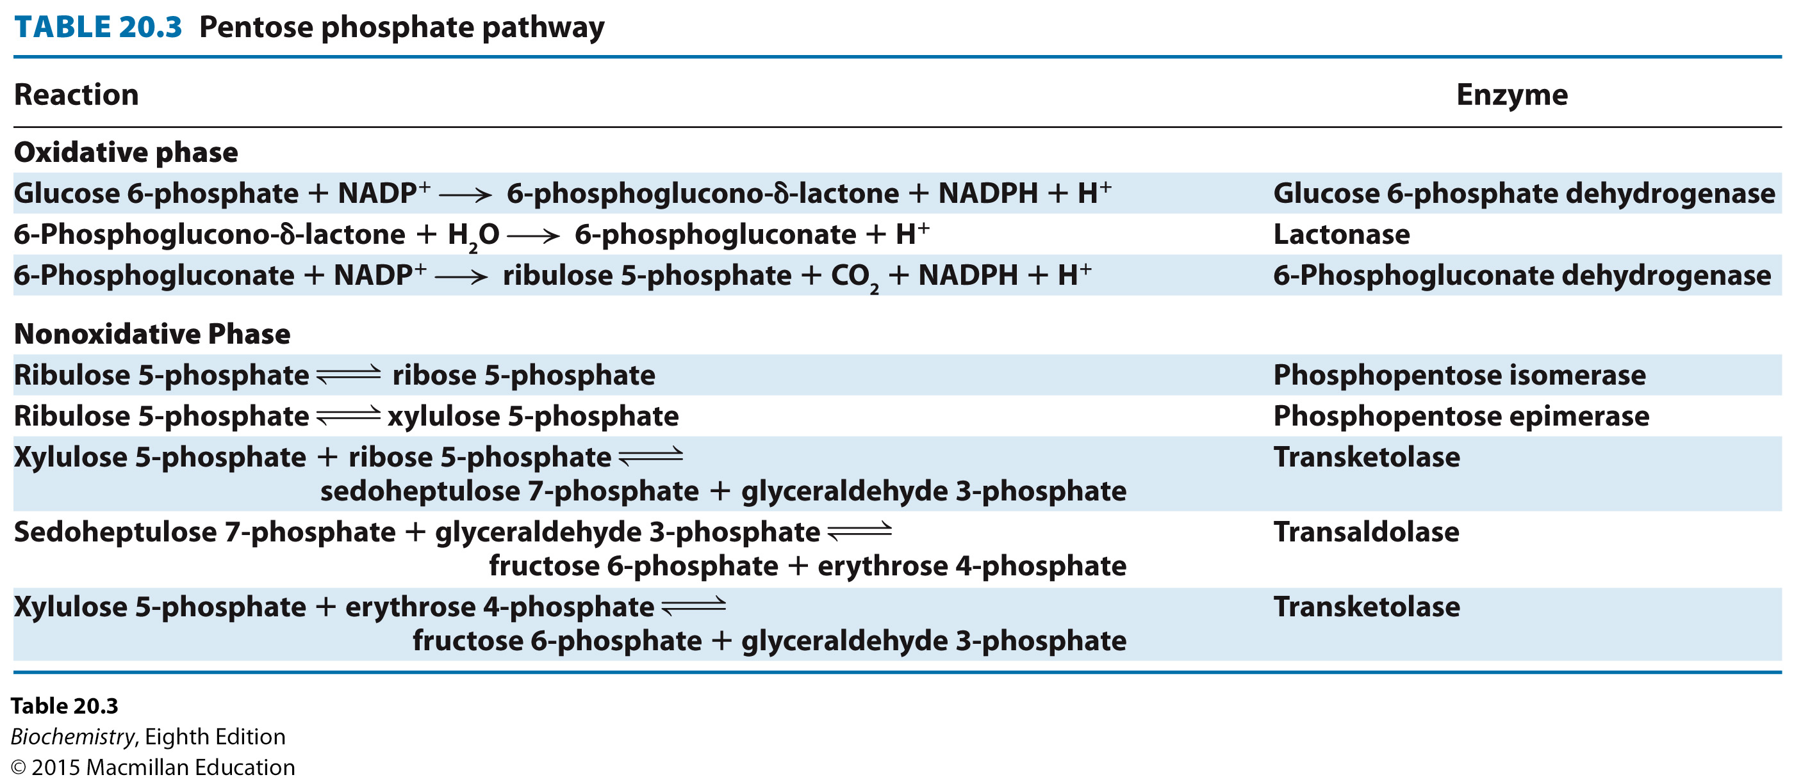

Slide 24
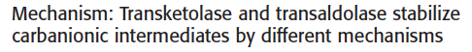
The transketolase reaction occurs as follows:
Thiamine pyrophosphate (TPP) forms a carbanion.
The carbanion attacks the ketose substrate.
A carbon-carbon bond is cleaved, releasing the aldose product and forming TPP joined to a two-carbon fragment, the glycoaldehyde intermediate.
The intermediate attacks the aldose substrate.
The ketose product is released and TPP is ready for another reaction cycle.

Slide 25
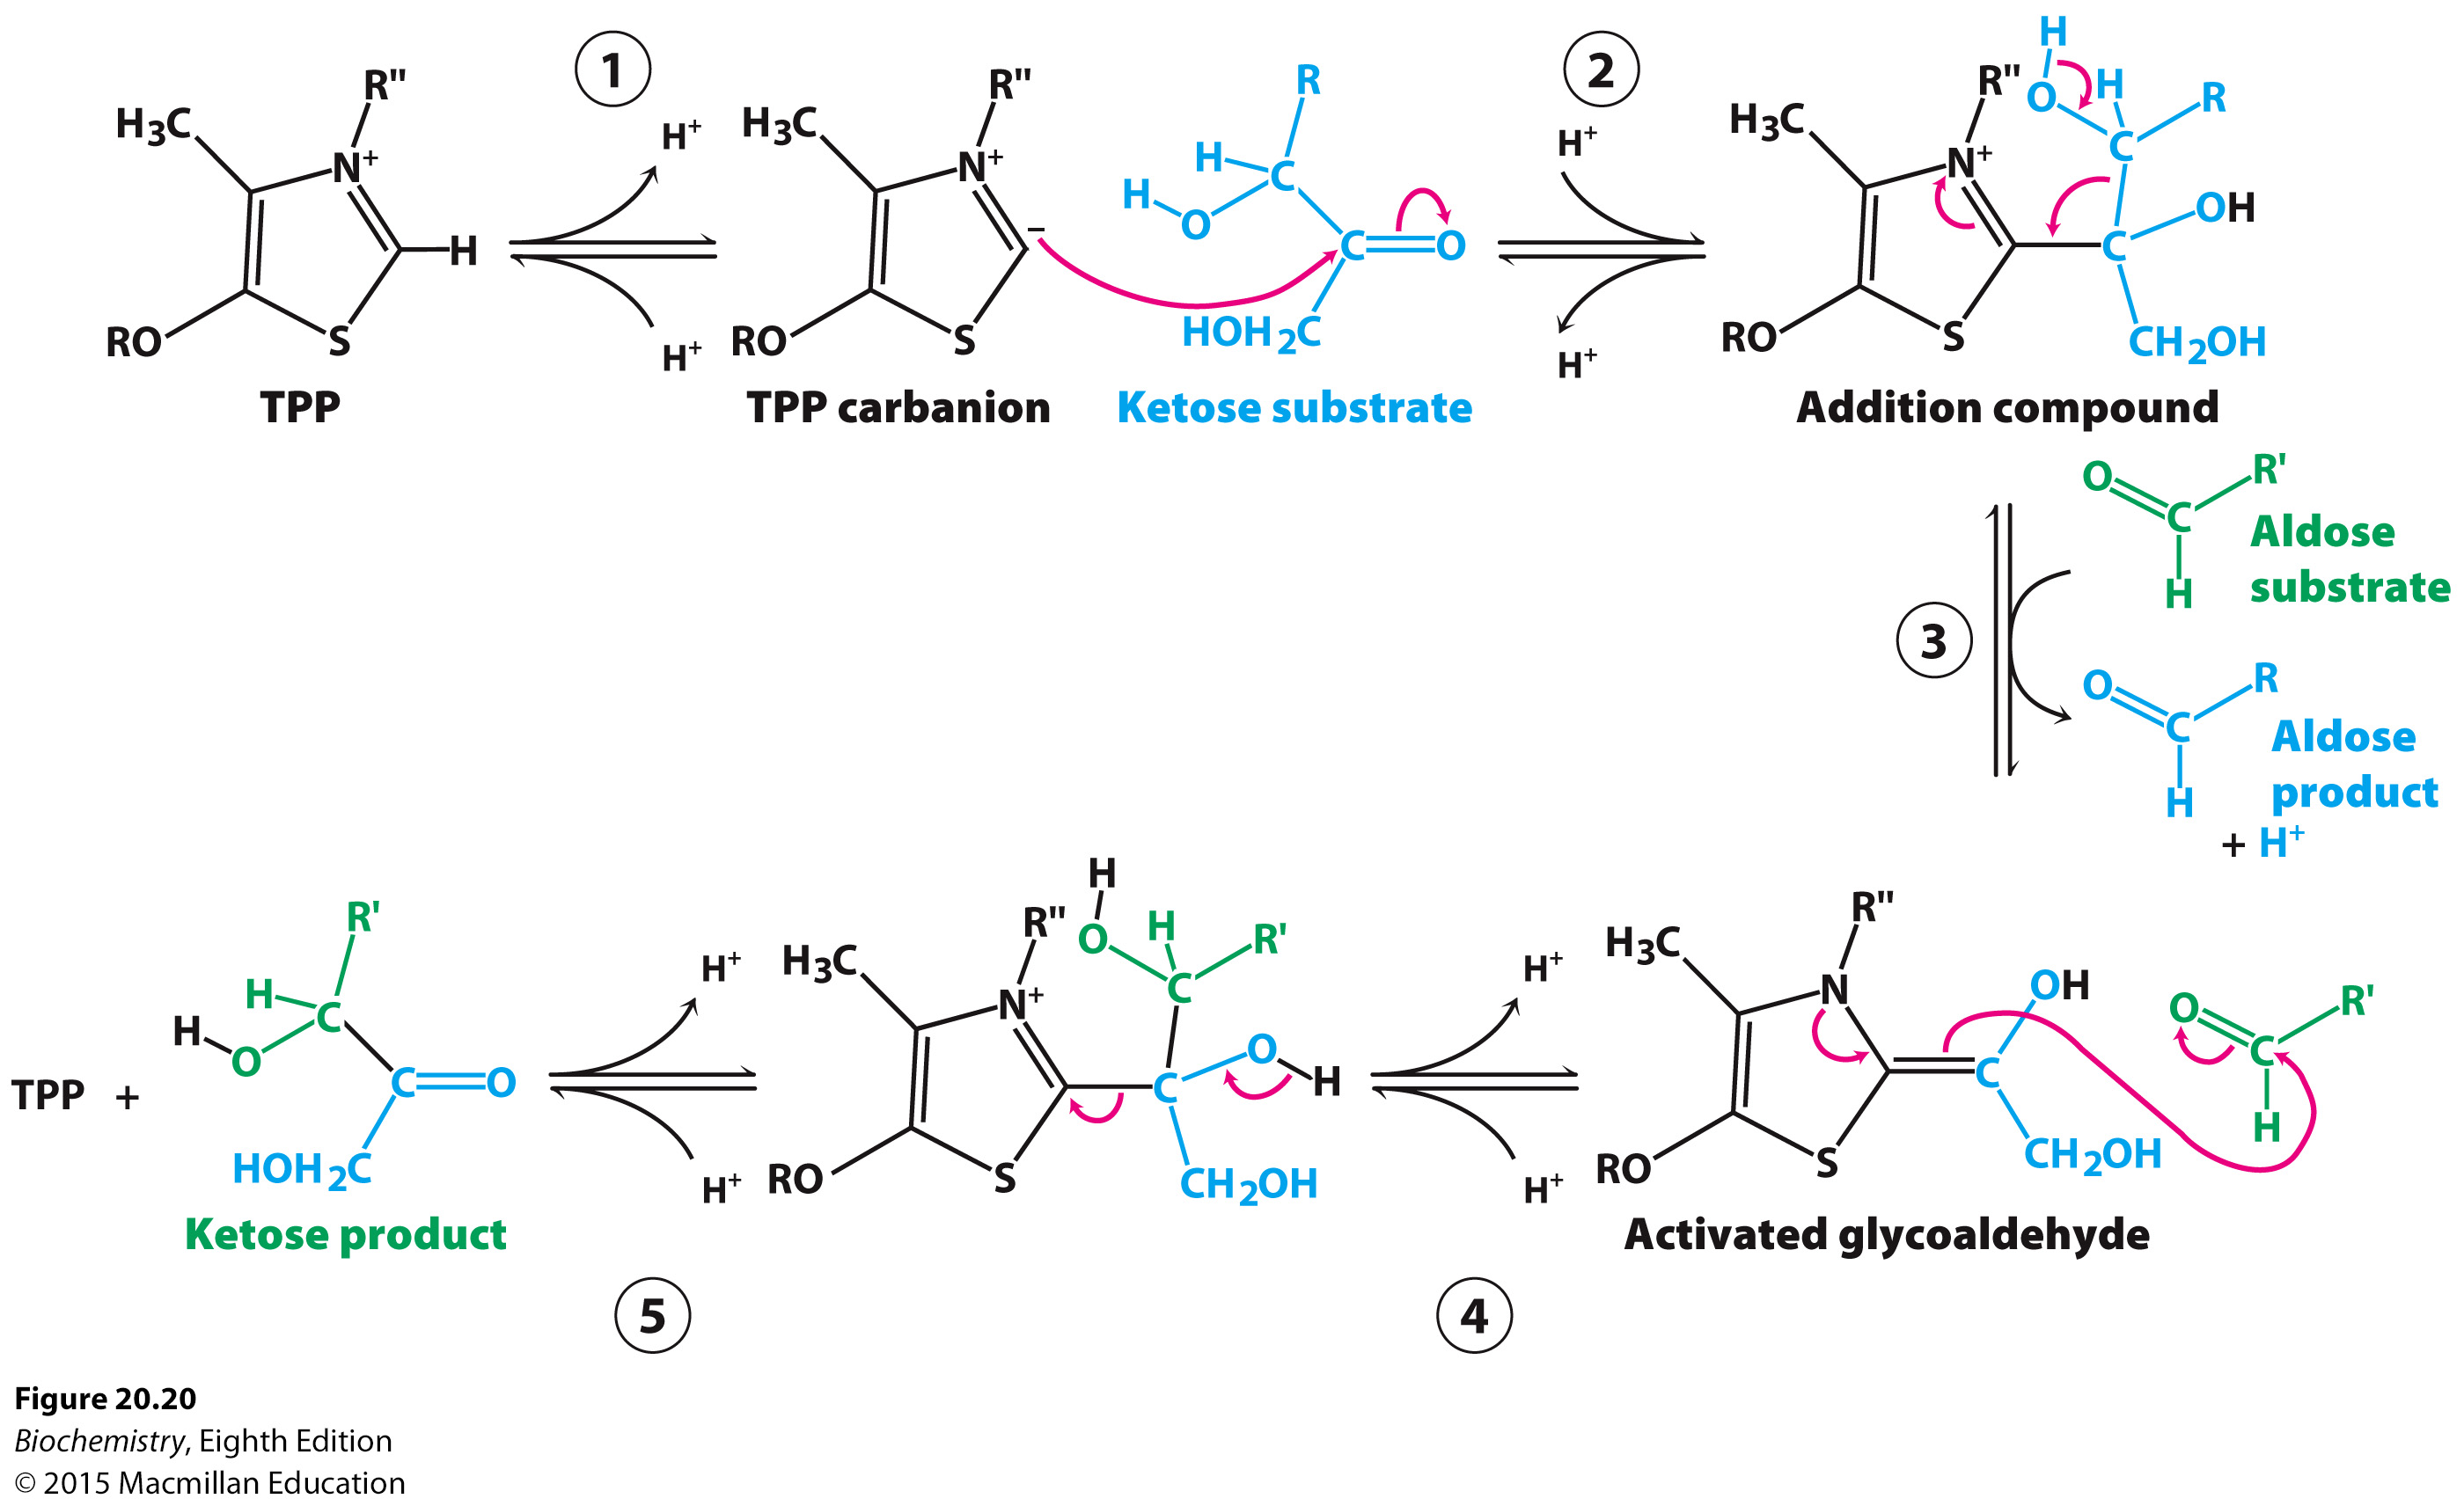
Notes:
FIGURE 20.20 Transketolase mechanism. (1) Thiamine pyrophosphate (TPP) ionizes to form a carbanion. (2) The carbanion of TPP attacks the ketose substrate. (3) Cleavage of a carbon–carbon bond frees the aldose product and leaves a two-carbon fragment joined to TPP. (4) This activated glycoaldehyde intermediate attacks the aldose substrate to form a new carbon–carbon bond. (5) The ketose product is released, freeing the TPP for the next reaction cycle.

Slide 26
The transaldolase reaction occurs as follows:
A Schiff base forms between the enzyme and the ketose substrate.
Protonation of the Schiff base results in the release of the aldose product.
The release of the aldose product generates a substituted enzyme intermediate.
The three-carbon fragment bound to the enzyme adds to the aldose substrate.
Deprotonation occurs.
Hydrolysis of the Schiff base releases the ketose product.

Slide 27
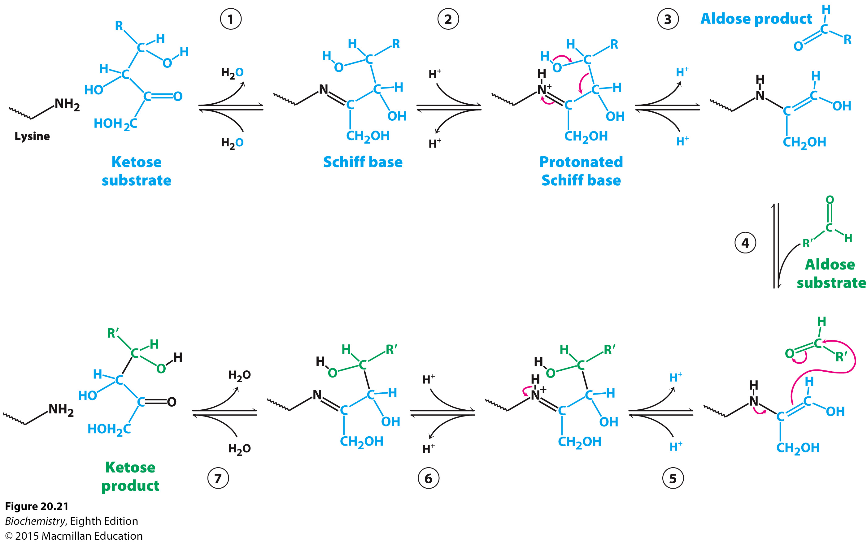
Notes:
FIGURE 20.21 Transaldolase mechanism. (1) The reaction begins with the formation of a Schiff base between a lysine residue in transaldolase and the ketose substrate. (2) Protonation of the Schiff base occurs. (3) Deprotonation leads to the release of the aldose product, leaving a three-carbon fragment attached to the lysine residue. (4) This intermediate adds to the aldose substrate. (5) Protonation occurs, forming a new carbon–carbon bond. (6) Subsequent deprotonation and (7) hydrolysis of the Schiff base releases the ketose product from the lysine side chain, completing the reaction cycle.

Slide 28
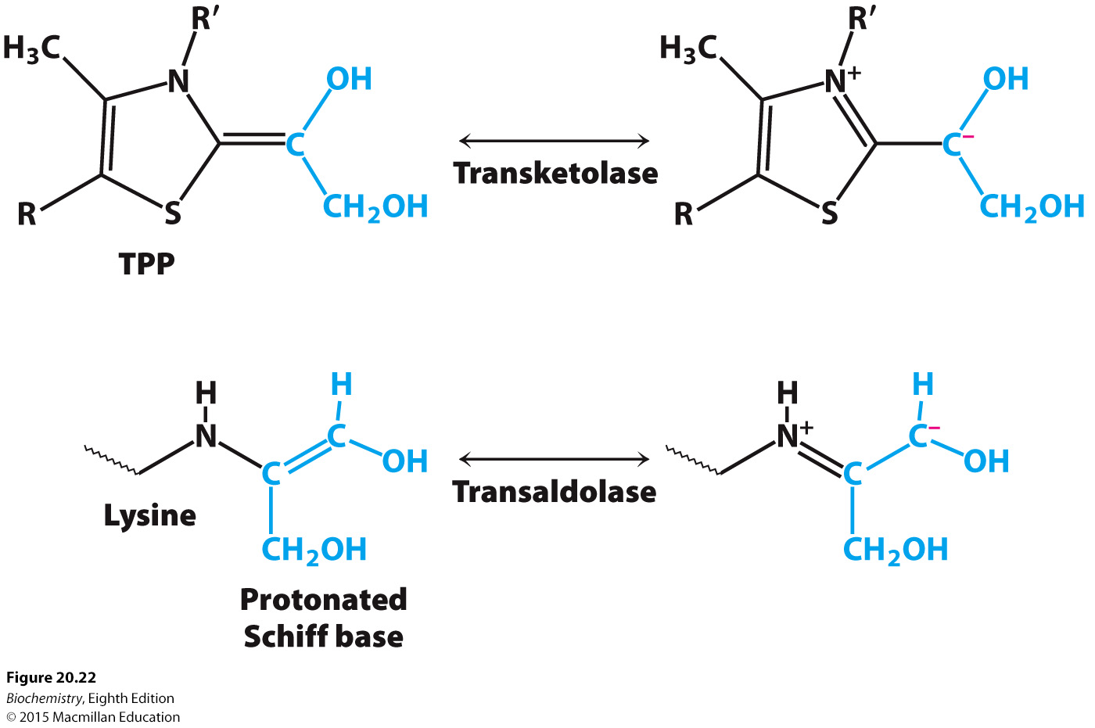
Notes:
FIGURE 20.22 Carbanion intermediates. For transketolase and transaldolase, a carbanion intermediate is stabilized by resonance. In transketolase, TPP stabilizes this intermediate; in transaldolase, a protonated Schiff base plays this role.

Slide 29
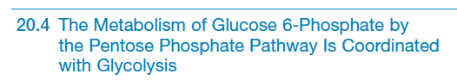
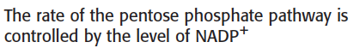
The first reaction of the pentose phosphate pathway, the dehydrogenation of glucose 6-phosphate by glucose 6-phosphate dehydrogenase, is the rate-limiting step of the pathway.
The most important regulatory factor is the concentration of NADP⁺.

Slide 30
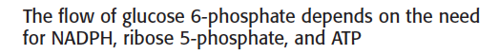
The pentose phosphate pathway can operate in four distinct modes that result from various combinations of the oxidative phase, the nonoxidative phase, glycolysis, and gluconeogenesis.
Ribose 5-phosphate needs exceed the needs for NADPH.
The NADPH and ribose 5-phosphate needs are balanced.
More NADPH is needed than ribose 5-phosphate.
NADPH and ATP are both required.

Slide 31
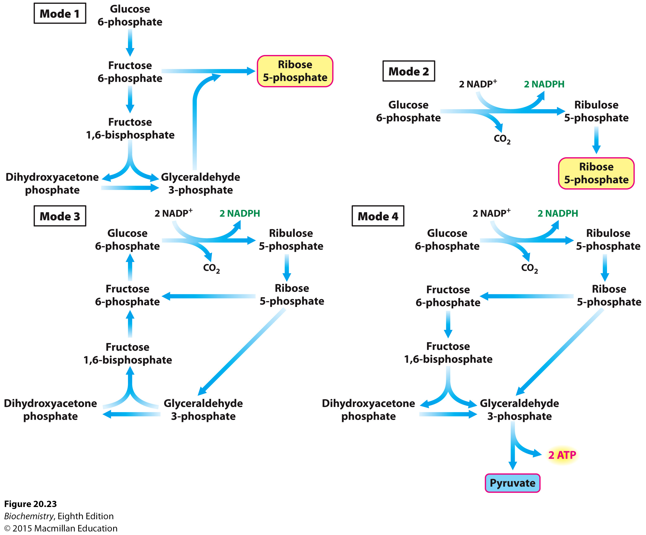
Notes:
FIGURE 20.23 Four modes of the pentose phosphate pathway. Major products are shown in color.

Slide 32
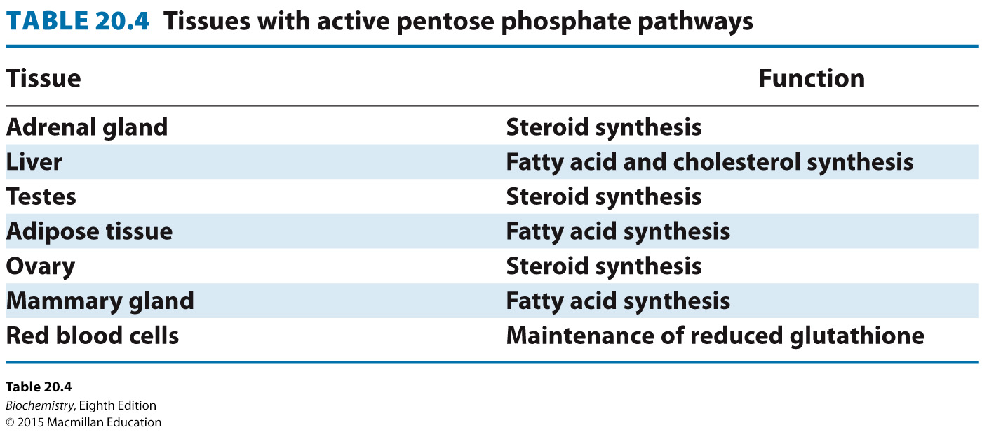

Slide 33
Rapidly dividing cells need ribose 5-phosphate for nucleic acid synthesis and NADPH for fatty acid and membrane synthesis.
Glycolytic intermediates are diverted into the pentose phosphate pathway by the expression of pyruvate kinase M, which has a low catalytic activity.

